Slide 1

Grid Navigation With tightly coupled Multiple robots
Qin Chen, Pranav Kumar, Richard Xu
Stanford Pre-Collegiate Summer Institutes 2016
July 29th, 2016

Slide 2
Brief Explanation
This is our final project with multiple robot navigation on the grid space and no unexpected obstacles.
This is implemented with a coupled approach, by generating all possible coordinates for the robots at one time, connecting them based on whether or not the robots can get from one position to another in one turn, and applying a Breath-First Search.
The algorithm works best with small, crowded graphs where the robots are required to make slick maneuvers.

Slide 3
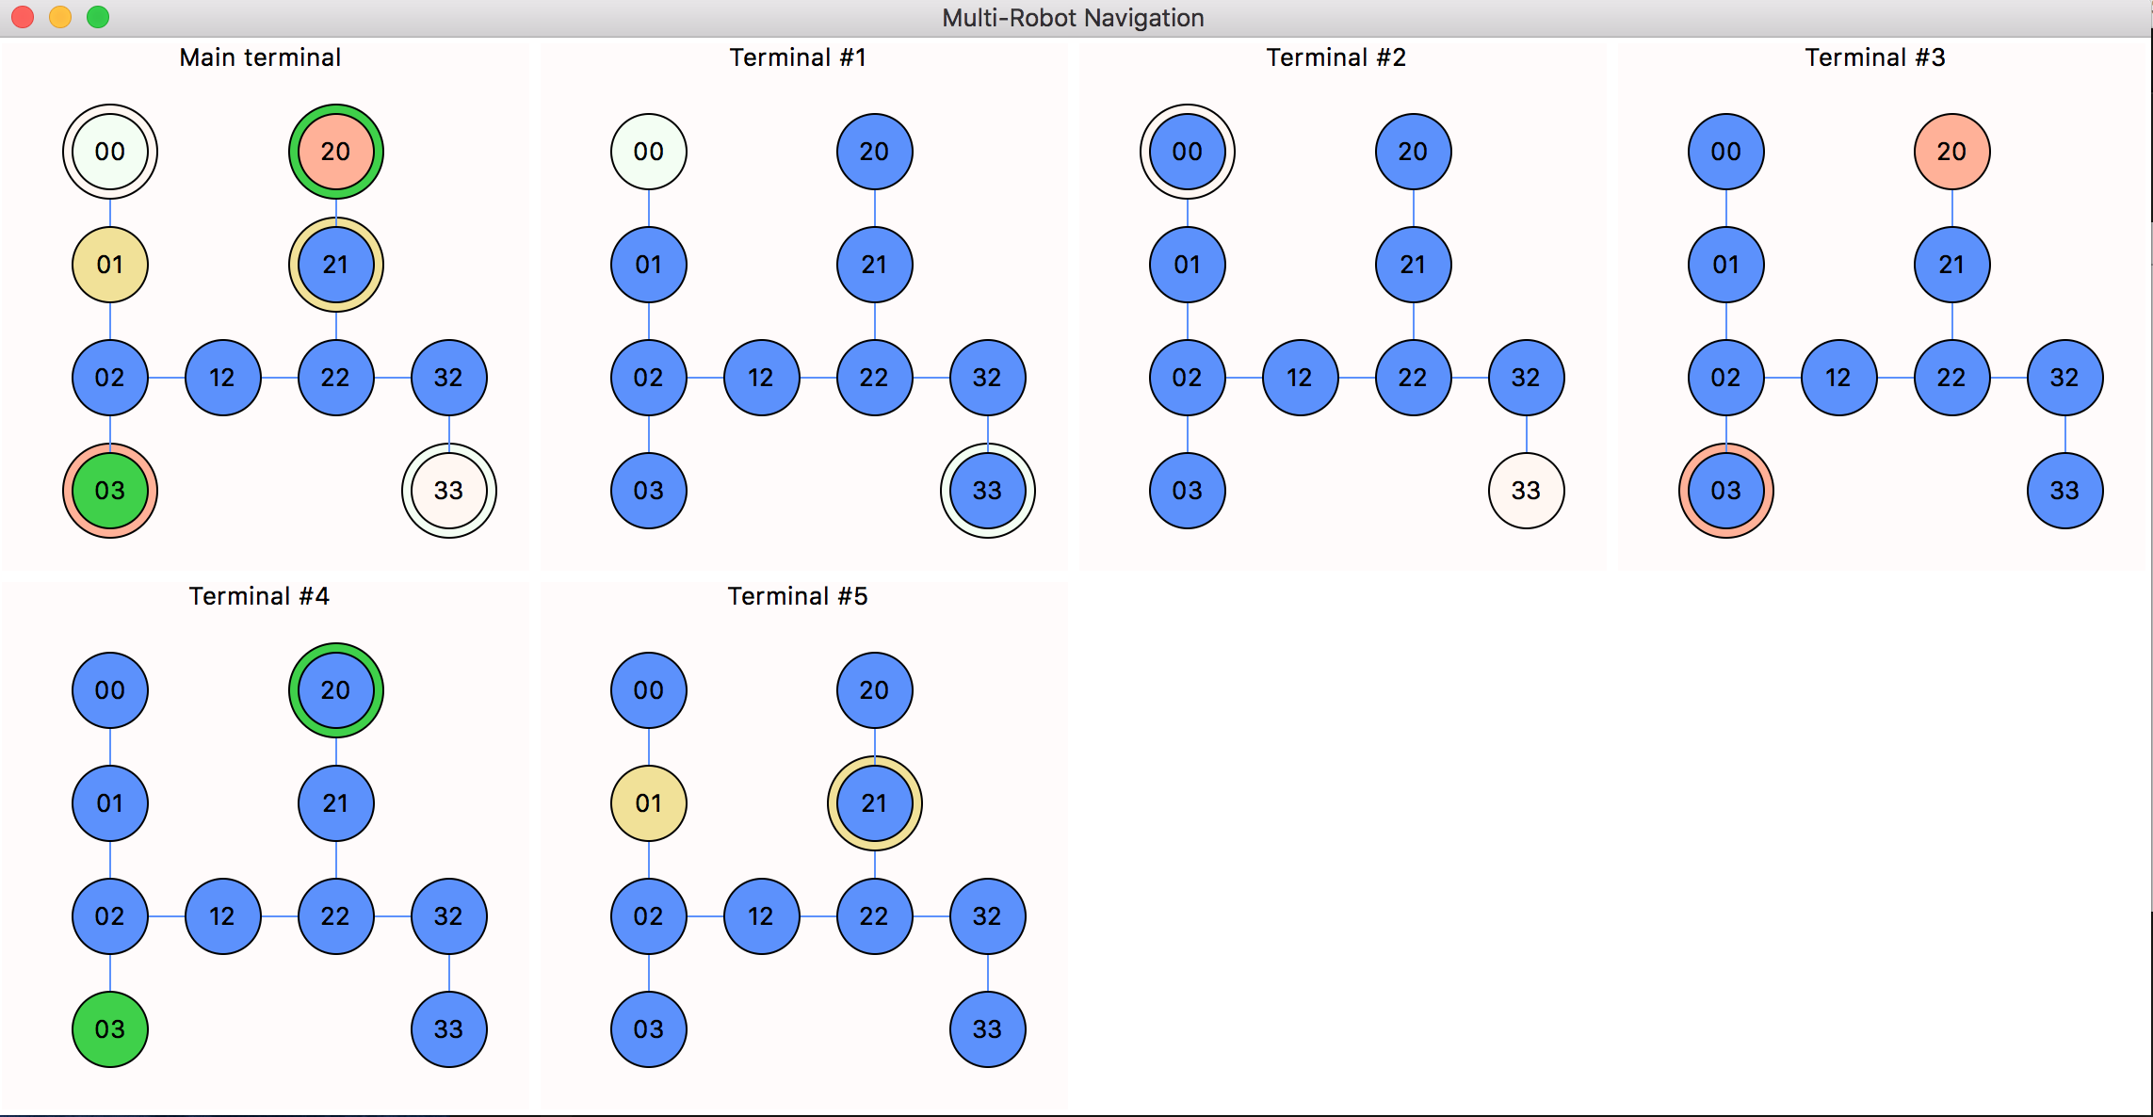
Quick Demo

Slide 4
A Thorough Explanation
See code!

Slide 5
Challenges
Not enough cooperation – we really didn’t work together well throughout the project, as Richard focused on the abstract part and Pranav focused on making the robots move.
“Sorry Pranav. I wasn’t trying hard enough for us to work together on the same project… I promise to try harder next time.” – Richard
“It’s fine.” - Pranav
Getting the Bluetooth working – some part of the way RobotComm_ble is written makes it so that a Tkinter frame in mainloop() is necessary for the robots to connect – even if the frames are completely empty. Weird, right?

Slide 6
Possible Improvements
You’re likely going to yell: “Now add unexpected obstacles!” Yes, we will add it. How do we do it?
1. Add ”not quit” for individualDrive, update quit to True when detecting an obstacle that is not a hamster, which is simple since we know which way each robot is facing and where each robot is.
2. When it quits under this state, it would add that to the obstacle list, update the start positions for robots, and re-run main()
The difficult part here is recognizing when an obstacle is within one grid from the robot, which will require some testing.

Slide 7
More Difficult Improvements
The program is slow for multiple robots, as it involves exponential time. However, many locations will not be reached, and the nodes are visited only once. The following implementation might be faster:
Implement A* algorithm with h(p) be the number of steps for each individual robot to get to its desired location, ignoring collisions. The vertices are generated as we move along, and since the graph has uniform edge cost, we only need to visit each vertex at most once.
The algorithm is still exponential time ☹ but it will likely get to the desired location much more quickly, especially for sparse graphs with little obstacle.
Notes:
Also, changing the language from Python to something faster, like Java/C++, might be helpful…

Slide 8
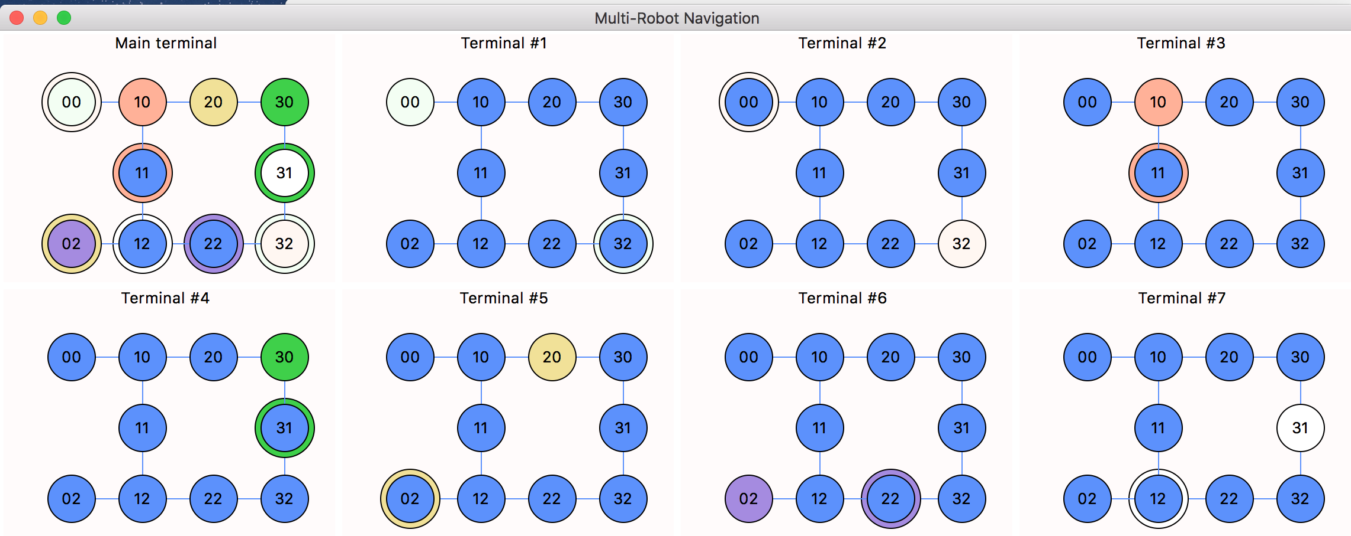
Final Demo

Slide 9
Thanks for watching and the amazing course!

